Slide 1
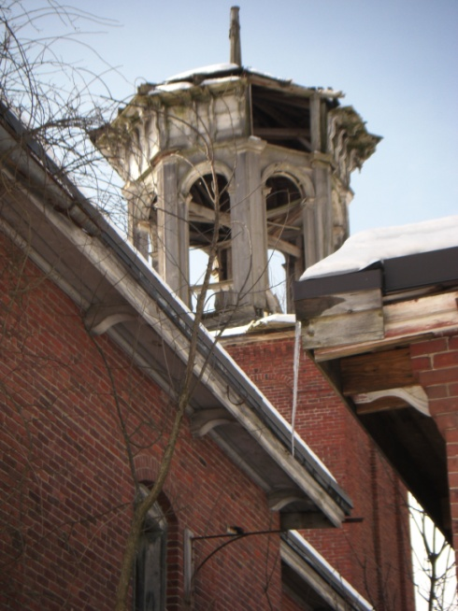
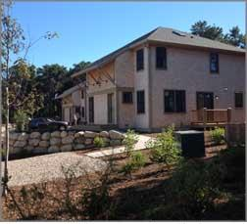
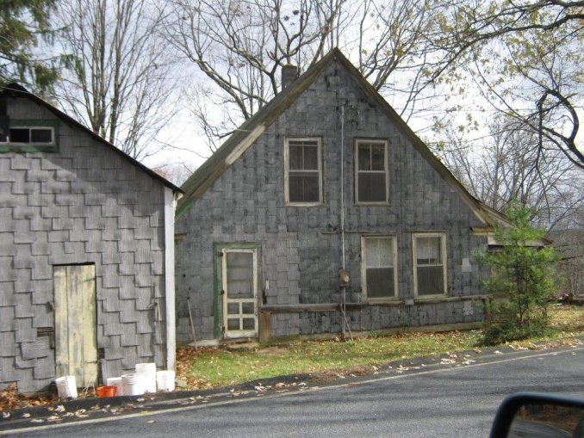
MHP’s Rural Housing Initiative Findings and Recommendations
December 18th, 2014

Slide 2
Mass. Housing Partnership
MHP is a self-supporting public nonprofit organization that works with state government and with business, civic and community leaders to increase the supply of affordable housing across the Commonwealth.
Notes:
First a quick primer on MHP
MHP is a privately-funded public non-profit organization
We provide permanent financing for new production and preservation of rental housing;
One mortgage program for first-time homebuyers,
TA to communities and non-profits
Policy work: Foundation for growth – land use and zoning, construction costs, and rural initiative

Slide 3
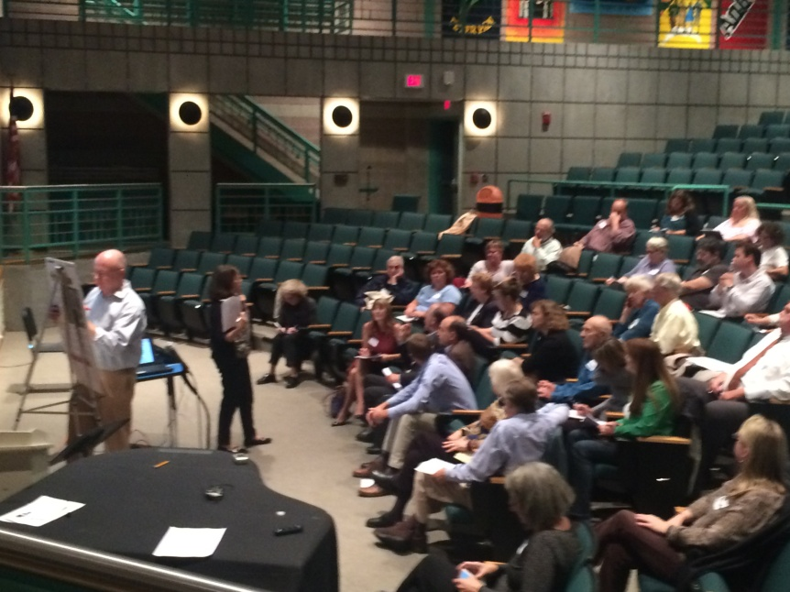
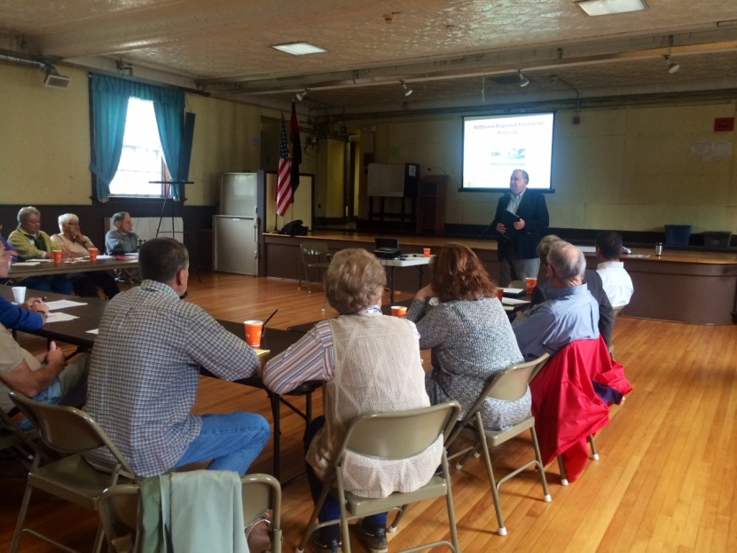
Rural Initiative Approach
Listening tour
Research and data collection
Investigate best practices from other states
Steering committee
Notes:
Rural communities are part of the MA “brand” but are “endangered” for a variety of reasons
Housing is our focus but we recognize that a targeted holistic approach that addresses a range of issues from economic development, transportation, healthcare and more are essential to communities not only surviving but also thriving.

Slide 4
What’s affecting rural housing?
Job losses and underemployment
Rapid increase in elderly population
Second home market pressures in some regions
Policies and programs that don’t recognize unique challenges
Notes:
Themes that emerged from our listening tour and initial meetings with stakeholders in rural communities

Slide 5
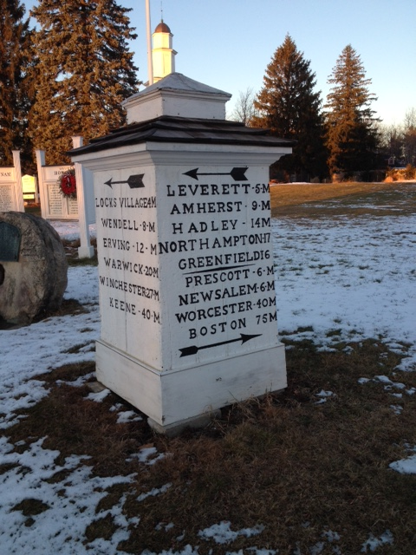
Rural MA Challenges
The Four I’s
Isolation
Infrastructure
Income
Investment
Notes:
I decided to provide you with an elevator speech about rural challenges that I fully expect you to commit to your memory
I made it simple for you – the four I’s
It will be easiest for those of you who wear glasses

Slide 6
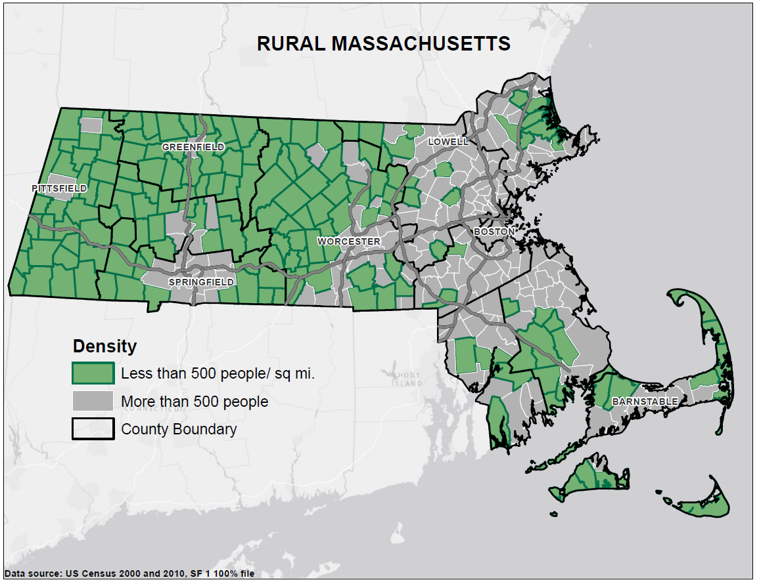
Isolation
Notes:
How did we define rural: fewer than 500 people per square mile same as Rural Access Commission
Encompasses 170 communities, 48% of land area and 13% of population
Includes range of population from just 75 (Gosnold) to over 23,000 (Middleborough)
There is a physical distance from center of power: Boston 115 miles from provincetown to boston, 157 miles from williamstown to Boston 150 miles from Mt Washington to boston
Often a real “political” disconnect that I have witnessed firsthand many times
Physical isolation for households that need to travel many miles for jobs and basic services such as healthcare , shopping, schools,

Slide 7
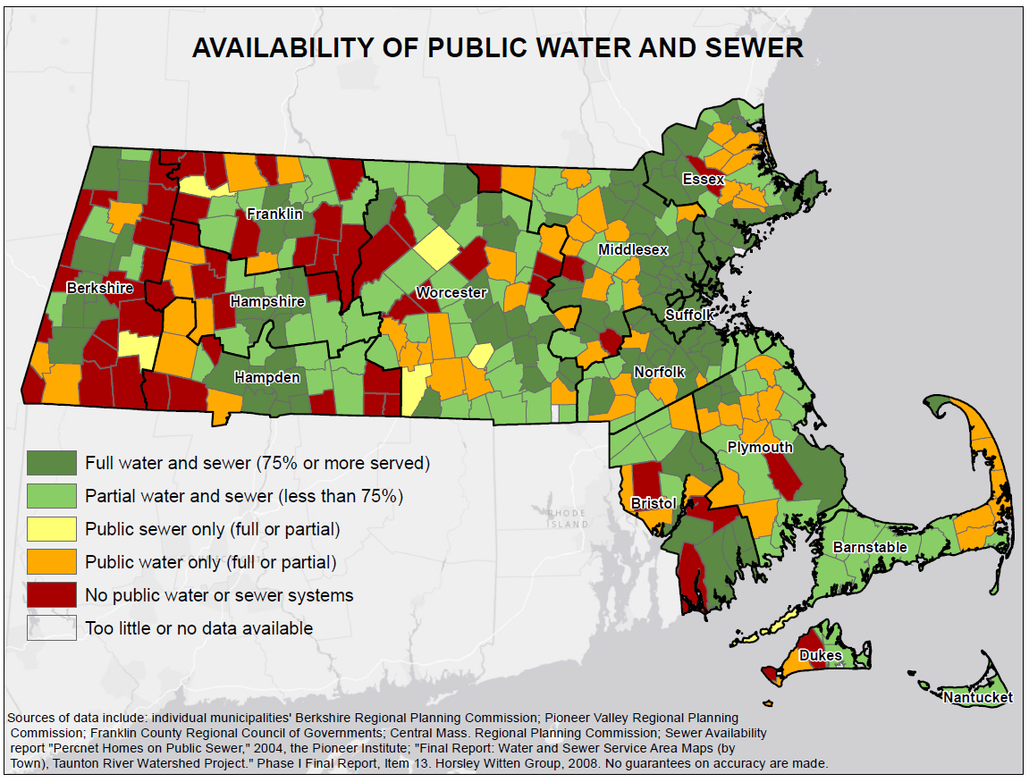
Infrastructure
Notes:
A good portion of rural areas do not have either public water or sewer- RED IS AREA WITHOUT WATER &SEWER
Those that do are often served in a small part of the community and have systems that are in need of major upgrades
Small tax base and distances makes upgrades or new installations prohibitive because of the high per capita cost
We don’t illustrate broadband here but many communities in western and central MA still do not have access to broadband - do we have a number? **no number- check out what I sent in email and see what you want to say

Slide 8
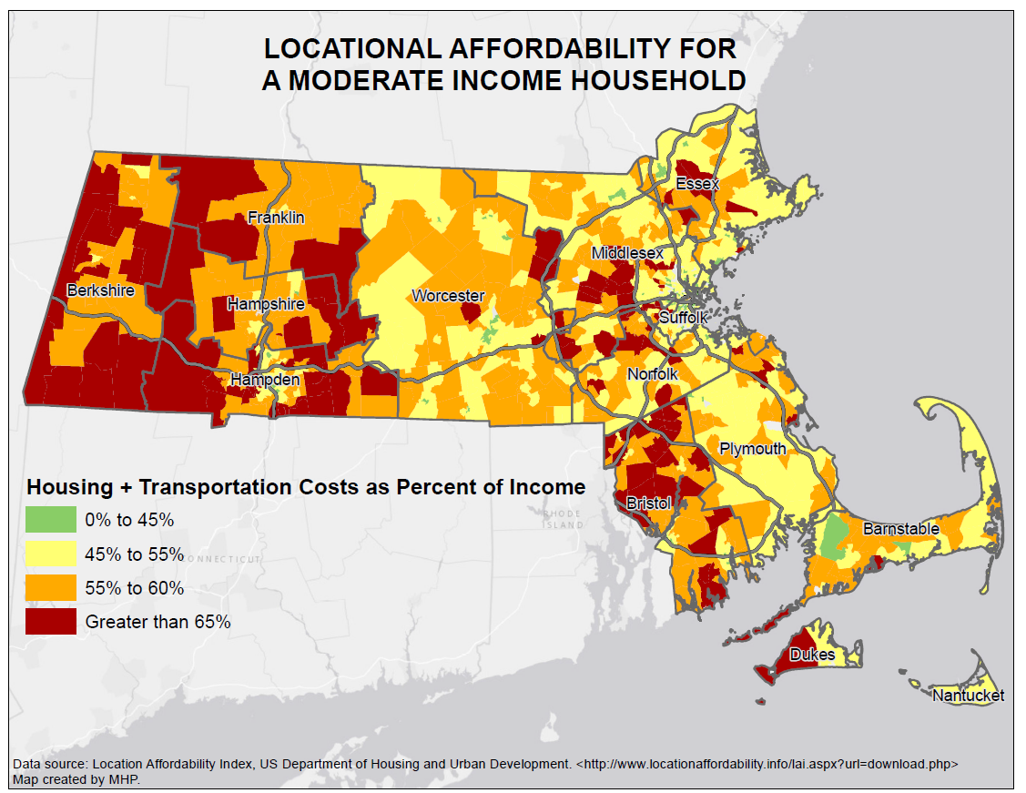
Income
Notes:
HUD considers household that spend more than 30% of their income on housing to be cost burdened. Statewide 34% of households cost-burdened, and overall rural areas are in that same range
But the Benchmark for housing costs + transportation is 45% -
this map show location affordability index for communities with many in rural areas paying well over 55% of their incomes and in many cases over 65% of their incomes for housing and transportation. AREAS IN RED OVER 65%

Slide 9
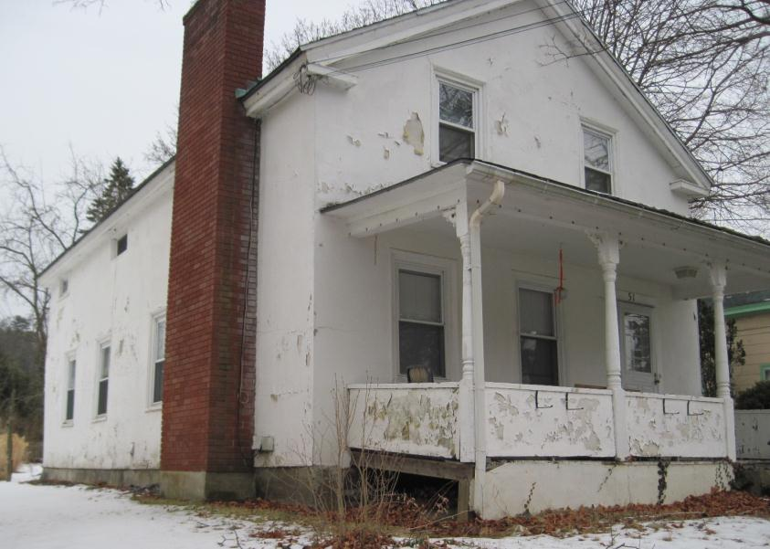
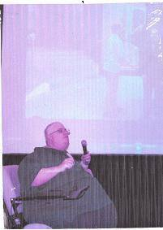
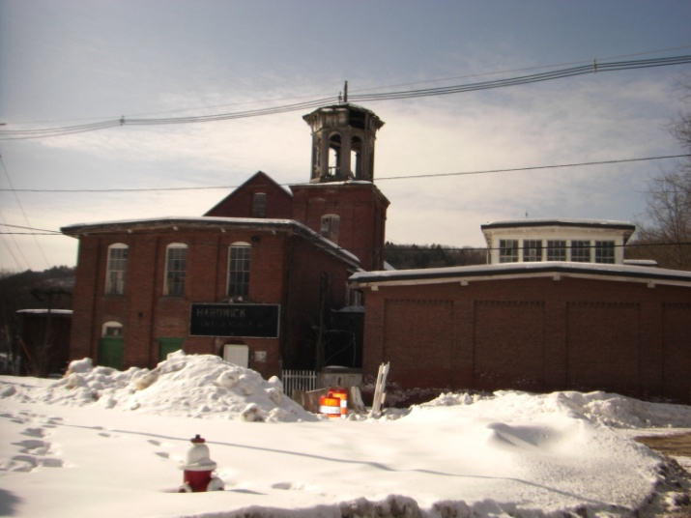
Investment
Need for additional investment in human and “hard” capital
House in need of rehabilitation in Berkshire County
Ty, housing recipient in Franklin County
Closed mill in Worcester County
Notes:
Many rural communities were hard hit by the loss of manufacturing jobs. Those jobs have not been replaced.
In our tourist oriented regions of Cape Cod and the islands and southern Berkshire counties many families live on low paying seasonal employment
Need additional investment in existing housing stock to insure health and welfare of a range of households from young families to the elderly
Think about reprogramming existing resources for housing rehabilitation and identifying new resources
Ty’s story of finding an affordable home
If we do not invest in water, sewer and broadband infrastructure it will continue to affect incomes, job growth and ability to create new housing for the changing population

Slide 10
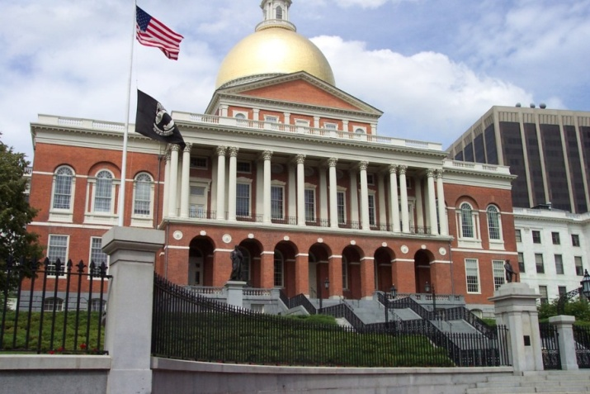
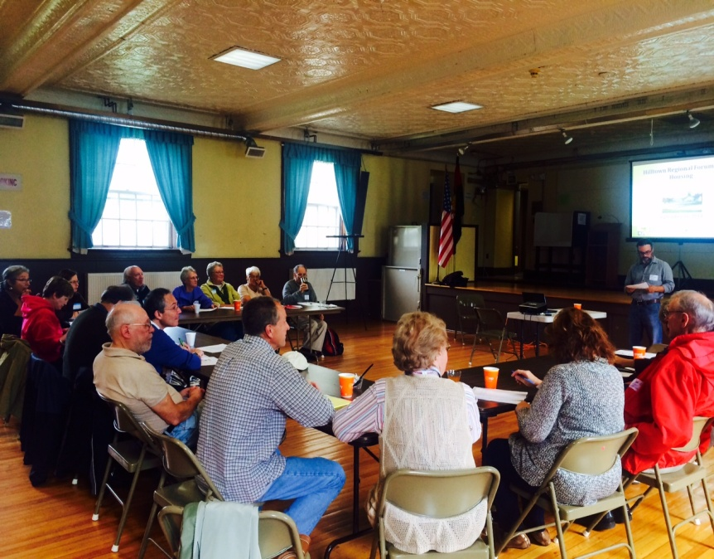
Policy Recommendations
Establish an
Office of Rural Policy
Facilitate & support
regional collaborations
to increase housing
affordability
Notes:
Establish an office of rural policy that will have oversight over state policies and programs that will function as a research and policy clearinghouse for issues critical to the health and welfare of rural communities:
Housing, health care, economic development, education, transportation, information technology
Enact policies and enact legislation as needed that will encourage and foster collaboration and regionalization to increase housing affordability

Slide 11
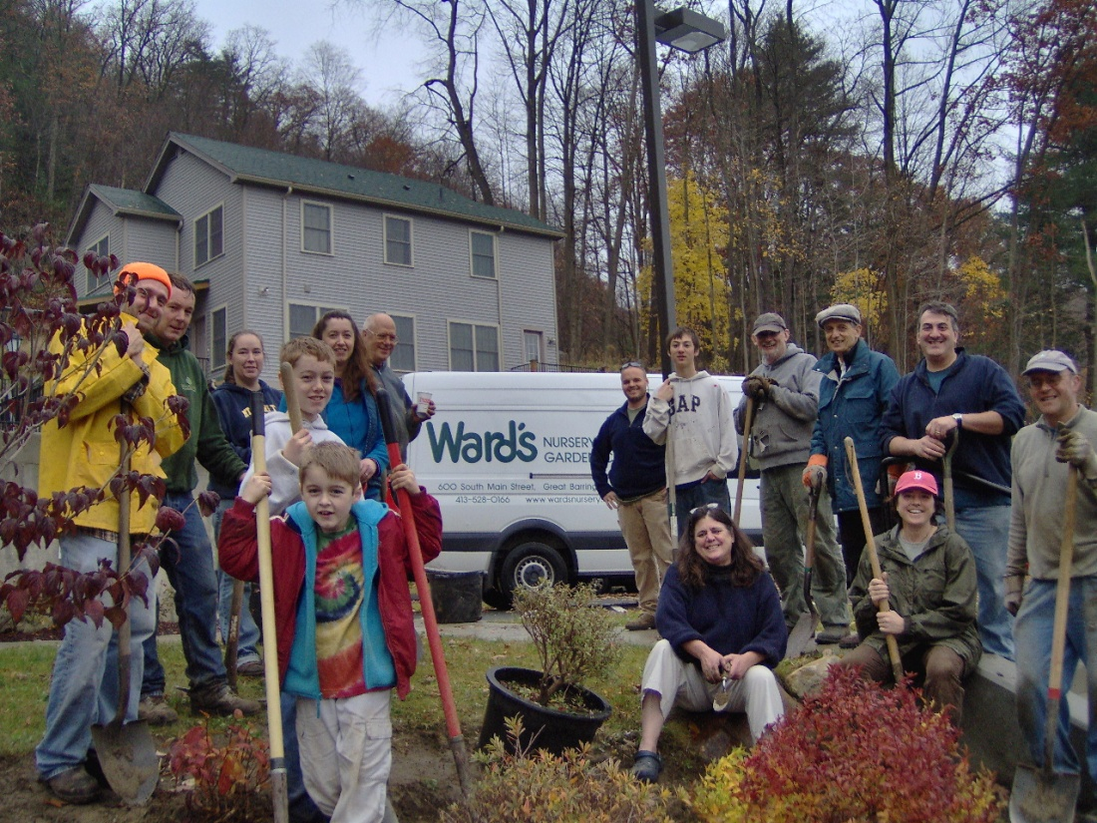
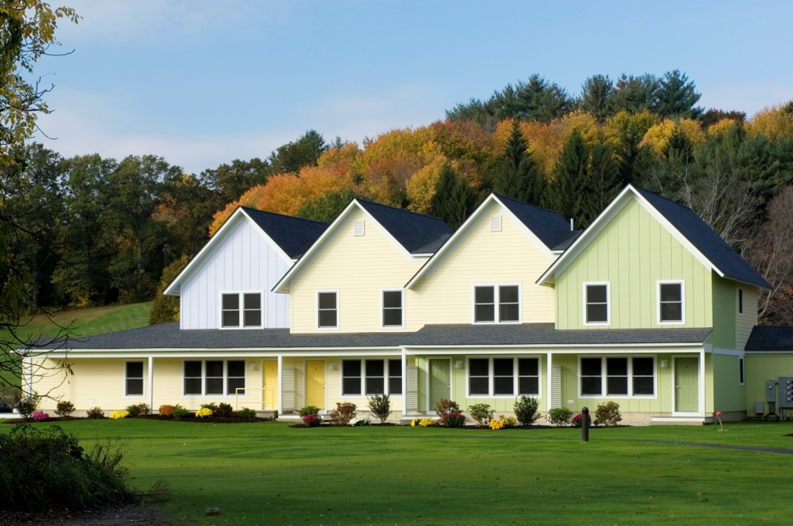
Program Recommendations
Small scale rental production program
Notes:
Create a small scale rental production program for developments of fewer than 20 units that cannot reasonably use LIHTC’s – there is a proven track record on these types of development – build to scale for community – don’t make deals compete with very large development
Hillside Apartments is a 10 unit new construction rental development in Great Barrington occupied in 2009 that has two units set aside for department of mental health clients. It is owned by CDC of south Berkshire and managed by Construct inc. Low turnover but two of the original tenants were able to purchase their own homes.

Slide 12
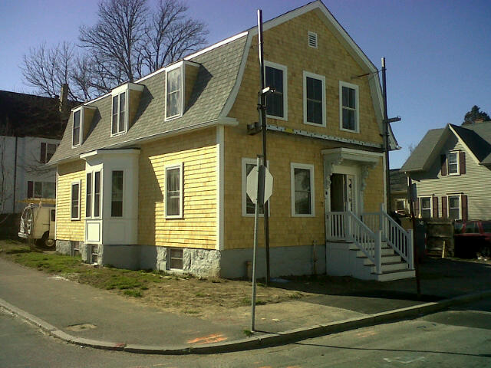
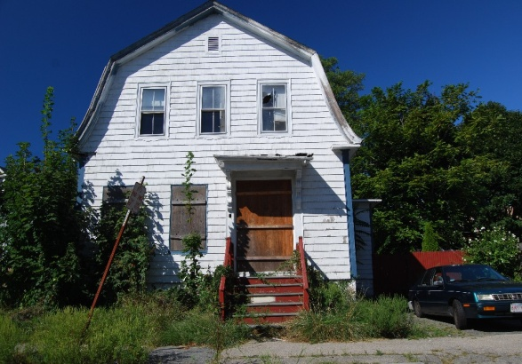
Program Recommendations
Community Development Block Grant (CDBG)
Dedicate greater level of resources
for rehabilitation
New and flexible state & federal financing mechanisms for water & sewer infrastructure
Notes:
Adapt and streamline programs such as CDBG and Housing Stabilization to better address the significant need for housing rehabilitation funding for rural communities.
Refine financing mechanisms for improvement or installation of public water systems – this will have a positive impact on public health, housing and economic development in rural communities.

Slide 13
Thank you to our Partners
Department of Housing and Community Development (DHCD)
MA Association of CDC’s (MACDC)
Citizens Housing and Planning Assoc. (CHAPA)
Community Econ Dev Assistance Corp (CEDAC)
Regional Housing Network(RHN)
Regional planning agencies, local CDCs & non-profits, and municipal officials
Notes:
MHP first convened a steering committee to work on the macro level goals of the initiative, and these members include DHCD, MACDC, CHAPA, CEDAC, RHN.

