Slide 1
Rural Maryland Council
Charlotte Davis
Executive Director
Rural.maryland.gov

Slide 2
Authorization
An independent state agency housed under Maryland Department of Agriculture
Authorization under the Agriculture Act of 2014 regarding the National Rural Development Partnership and State Rural Development Councils
First established in 1993 by Governor’s Executive Order. Formally established in Maryland Statute in 1995 (Economic Development Article, Sec. 13-401)

Slide 3
Mission
Serves as a partnership of federal, state and local governments, together with the private sector, to improve the quality of life of all citizens of rural Maryland.
The only entity in state government specifically designed to convene rural leaders across the state and across disciplines to identify economic development challenges common to rural areas and to develop and implement realistic, workable solutions.

Slide 4
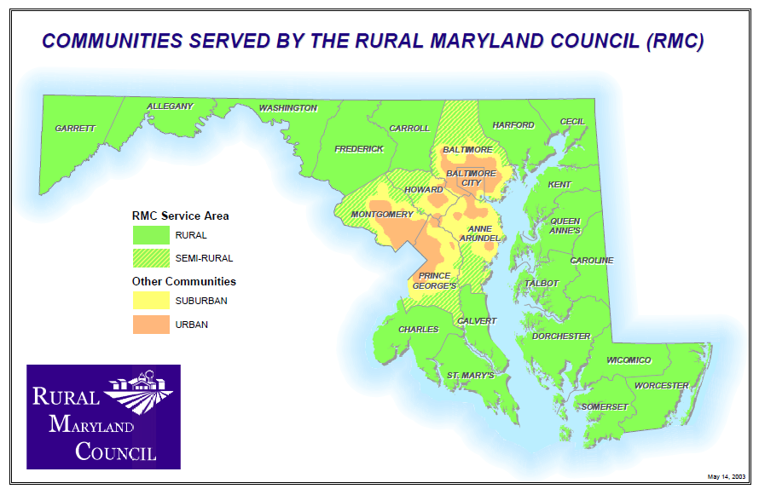

Slide 5
Challenges in MD’s Rural Areas
Higher Unemployment rates in rural
Overall, the rural unemployment rate is 7.98%. The State’s overall unemployment rate is 6.7%. The suburban/urban rate is 6.48%. Subtracting out the City of Baltimore, the suburban rate is even lower at 5.86%.
Somerset Co (10.8%) and Dorchester (10.5%) both have the highest unemployment rates, not only among the rural areas, but in the State.

Slide 6
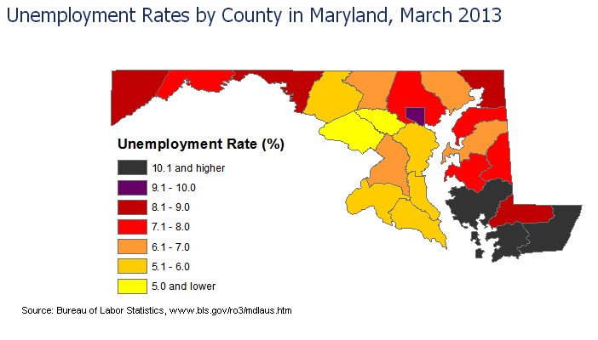

Slide 7
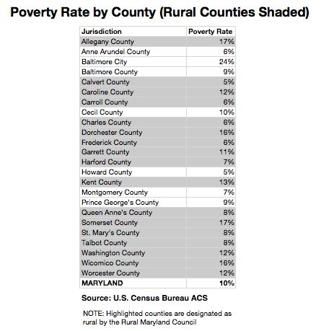
Other Challenges
Lack of transportation options
Lack of access to high speed internet
Health care provider shortages in rural areas
  Higher rates of obesity, smoking and drinking
  Care for stroke patients is an issue
Regulatory changes in agriculture
Lower rates of education attainment beyond high school

Slide 8
Rural Maryland population
2010 Population
Urban Rural
Baltimore City 620,961 Harford County 244,826
Suburban Frederick County 233,385
Montgomery County 971,777 Carroll County 167,134
Prince George’s County 863,420 Washington County 147,430
Baltimore County 805,029 Charles County 146,551
Anne Arundel County 537,656 St. Mary’s County 105,151
Howard County 287,085 Cecil County 101,108
Total Suburban 3,464,967 Wicomico County 98,733
Calvert County 88,737
Total Maryland 5,773,552 Allegany County 75,087
Worcester County 51,454
Queen Anne’s County 47,798
Talbot County 37,782
Caroline County 33,066
Dorchester County 32,618
Garrett County 30,097
Somerset County 26,470
Kent County 20,197
Total Rural 1,687,624

Slide 9
Mass Population
TOTAL 6,349,097
Barnstable County 222,230
Berkshire County 134,953
Bristol County 534,678
Dukes County 14,987
Essex County 723,419
Franklin County 71,535
Hampden County 456,228
Hampshire County 152,251
Middlesex County 1,465,396
Nantucket County 9,520
Norfolk County 650,308
Plymouth County 472,822
Suffolk County 689,807
Worcester County 750,963

Slide 10
Density
Massachusetts
  Total population considered rural (million) 1.9
  Percent of population considered rural: 30.6
  Percent of land area considered rural: 79.5
  Population density (people/sq mile) 839.4
Maryland
  Total population considered rural: 1.6
  Percent of population considered rural: 25
  Percent of land area considered rural: 75
  Population density (people/sq mile): 594.8
Both states are considered heavily urbanized

Slide 11
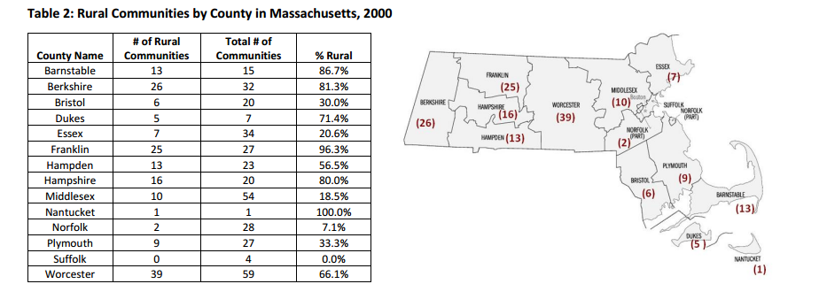
MASS Rural Communities

Slide 12
Mass Rural Challenges
The Patrick Administration and the legislature, in FY13, commissioned the Rural Access Commission to address the distinct needs of rural communities and to uphold the Commonwealth’s commitment to supporting the success of every individual and family in the state.
http://www.mass.gov/eohhs/docs/eohhs/rural-services-commission-report.pdf
Priority areas:
  Increase access to transportation
  Develop an enhanced and coordinated state infrastructure that identify and address rural workforce needs
  Implement data-driven and evidenced based strategies to address health care worker shortage in rural communities
  Address Family Child Care Provider shortage for children in state funded slots
  Expand broadband access to rural communities and service providers

Slide 13
MA/MD Agriculture

Slide 14
Challenges to MD rural Governments
Population/Density
  Lower returns on investment
  Greater need for state subsidies
State Government Representation
Partisan Considerations

Slide 15
State Government Representation
In 1962, Baker V. Carr, the U.S. Supreme Court formulated the famous "one person, one vote" standard.
  The case pertained to legislative redistricting.
  The Court held that each individual had to be weighted equally in legislative apportionment
  The Court decided that in states with bicameral legislatures both houses had to be apportioned on this standard, voiding the provision which had provided for two state senators from each county.
This re-apportionment increased the political power of urban areas and reduced the influence of more rural areas.

Slide 16
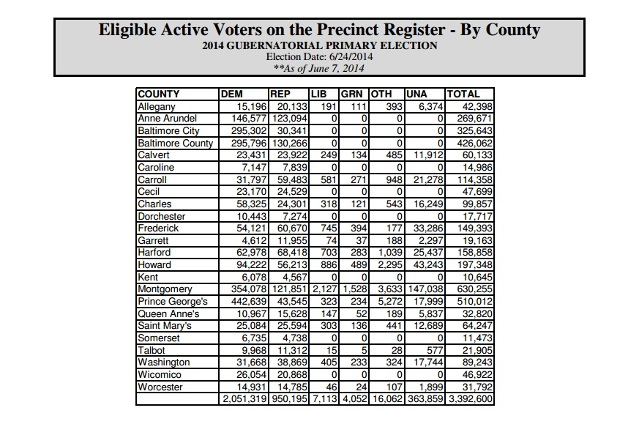

Slide 17
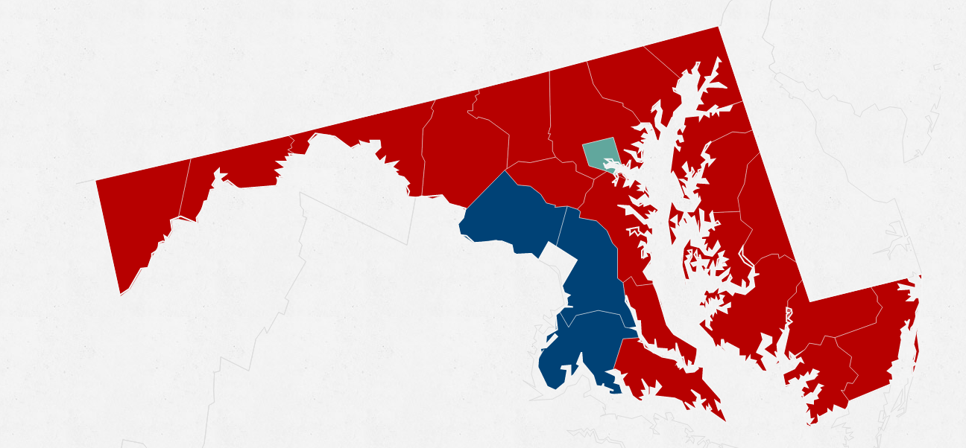
2014 MD Gubernatorial election Results

Slide 18
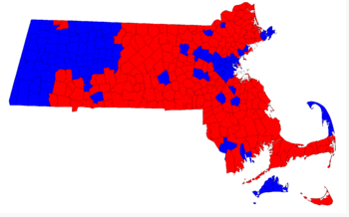
2014 MA Gubernatorial election results

Slide 19
Partisan
As of January 8, 2014, the 47-member Senate has 35 Democrats(74%) and 12 Republicans (25%) although the recent elections brought in more Republicans
  Not enough Republicans to sustain the Governor’s veto
  Cannot sustain a filibuster
The 141-member House of Delegates includes 98 Democrats (69.5%), and 43 Republicans (30.5%).
All State-wide office holders are currently Democrats although a new Republican Governor will take office in January 2015 (only second time since the 60s)
However, the past election saw high turnout of rural voters, while suburban and urban voters mainly stayed home.
  Record low turnout of 39% in suburban Montgomery County
Loss of moderate Democrats and Republicans

Slide 20
Strategies
Create coalitions with other organizations and individuals
Reach out to suburban and urban counterparts on shared interests – rural can’t go it alone
Focus on parity and fairness

Slide 21
RMC’s Advocacy ROLE
Strategic assessment of council members showed that overwhelmingly members wanted the council to have an advocacy role
  Develop a list of budget and policy priorities
  Host an advocacy day
  Host an informal breakfast for new rural legislators
  Draft and support legislation
  Testify before legislative committees
Work with the Legislature to direct funding to rural areas
Help support the Rural Caucus

Slide 22
RMC Programs
Administer the Maryland Agricultural Education and Rural Development Assistance Fund (MAEFDAF) which distributes small grants to rural-serving nonprofits
  FY 15, RMC awarded $170,000 to 17 organizations
Administer a second Fund that aims to increase standards of living in rural areas to meet statewide averages
  Focus on Regional Councils, Entrepreneurship, Infrastructure, MAERDAF and Health Care
  Currently unfunded

Slide 23
RMC Research
Recently completed a youth assessment in the Upper Shore area
Surveyed middle and high school students about their perceptions of their communities
  58% rate their community as an above average to excellent place to live as a young person.
  51% picture themselves living in their hometown area in the future, if quality career or business opportunities are available.
  69% feel their community is a good place to raise a family, while 57% feel there are better career opportunities available elsewhere.
  47% of youth surveyed are interested in owning their own business in the future.
  76% of youth surveyed said that they have never been asked by an adult to become involved in improving their community, while 74% said they would volunteer if asked.

Slide 24
RMC Youth Assessment and Engagement
The findings of this project will provide information to community leaders to encourage them to build upon the too often untapped involvement and energy of young people in socio-economic and business planning strategies.
Community leaders will be equipped to take direct actions to engage and cultivate the full potential of youth populations.
Utilizing the information obtained from this project will create goals for youth engagement, retain and attract young adults and families to our region.

Slide 25
RURAL WHITE PAPER RECOMMENDATIONS
Create a State Office of Rural Policy that would function as a research and policy clearinghouse
  Where is this office housed?
  RMC has been housed in DHCH, DBED and MDA
Encourage, facilitate and support regional collaborations to increase housing affordability
  RMC is organizing regionally in the rural areas to determine community development needs
  Have seen that we have affordable and adequate housing stock, but not quality

Slide 26
State Rural development Councils
Twenty-eight federally recognized councils
Guiding Principles:
  Equal Standing of all partners
  Commitment to the grassroots
  Flexibility – one size does NOT fit all
  Creative/collaborative solutions
  Partnerships
  Focus on enabling rural communities to achieve their goals and objectives

Slide 27
Rural Issues can be overwhelming
Cuts across so many policy areas
  Education
  Agriculture
  Economic Development
  Community Development
  Land Use
  Health care
  Infrastructure

Slide 28
Rural vs. Urban
In MD, we have found that our rural and urban areas share the same challenges
It’s just the solutions are different!
Not one size fits all
  What works in suburban Bethesda, often won’t work in Oakland
  Example: Complete Streets policy

Slide 29
Rural Matters!
Food, fiber and fuel
Local food has become increasingly more in demand
  Need to ensure access to affordable land
  Grow food, not houses
Energy production occurs in rural areas
  Renewable energy facilities such as wind and solar
  Natural gas production and export
  Wood energy

Slide 30
Charlotte Davis
Executive Director
Rural Maryland Council
50 Harry S. Truman Parkway
Annapolis, Maryland 21401
(410) 841-5774
Charlotte.davis@maryland.gov

